Slide 1


NRU HSE
Faculty Of Economic
Sciences
CAN IMPLIED VOLATILITY
PREDICT RETURNS ON THE CURRENCY
CARRY TRADE ?
НИКОМУ НЕ ИЗВЕСТНЫЕ ПИ*РАСЫ
LOZOVOY
VLADIMIR
KUSLAIKIN ALEXANDER
BYZOV
ALEXEY

Slide 2
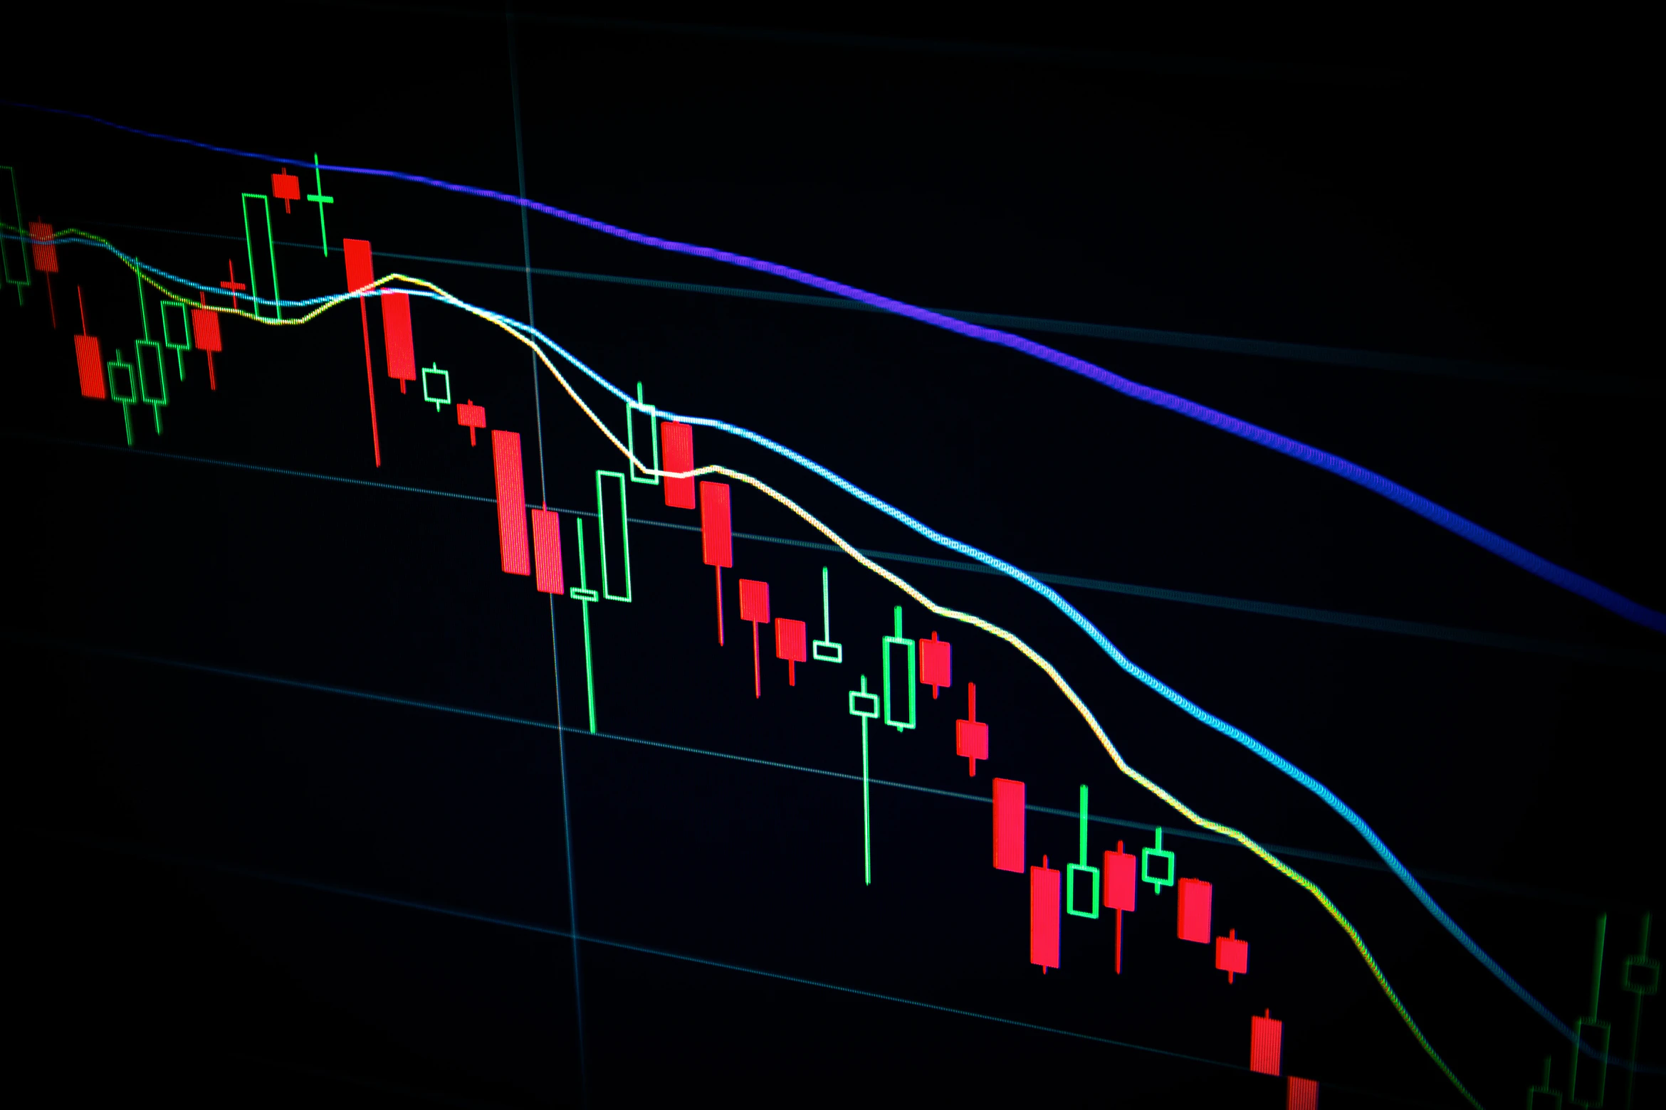
Can implied volatility predict returns on the currency carry trade?
Egbers T., Swinkels L.
Journal of Banking & Finance, 2015
Byzov Aleksei Kusliaikin Aleksandr Lozovoy Vladimir

Slide 3
Part I. Presentation of original results

Slide 4
Relevance and general idea
Currency carry trade – currency investment strategy, presuming taking long positions in high-yield currencies and taking the simultaneous short positions in low-yield ones
Existing understanding:
1
Sharpe ratios of currency carry trade returns are similar to Sharpe ratios in equity market
2
Exchange rates of investment currencies «go up by stairs and down by elevator»
3
UIRP does not hold in short-term but approximately holds in long-term period
Contributions of considered research:
1
Trial to explain optimal timing for currency carry strategy based on implied volatility
2
Additional empirical testing of UIRP concept

Slide 5



Literature review
Trials to explain currency carry trade through implied volatility
Brière and Drut (2009); Ilmanen (2011)
Egbers T., Swinkels L.
2015
Empirical literature on the UIRP puzzle findings
Chinn (2004);
Chinn (2011); Chinn (2013);
Attempts to explain currency carry trade returns
Burnside (2012); Dobrynskaya (2014); Aloosh (2015);

Slide 6
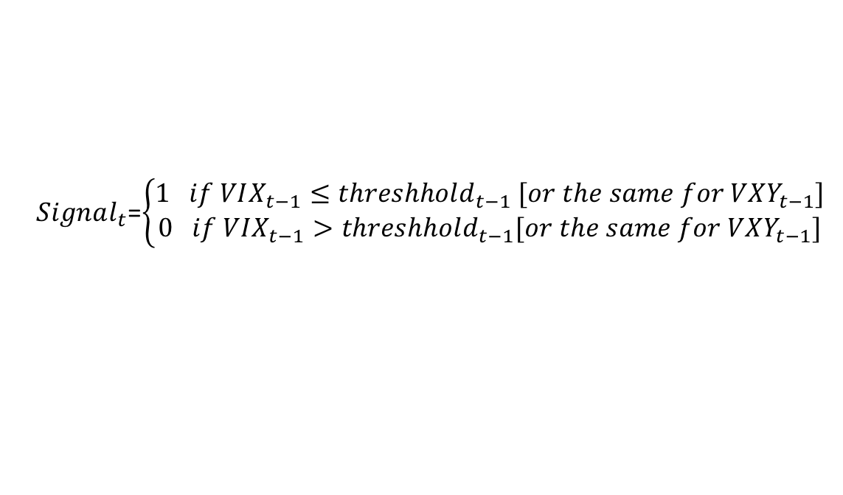
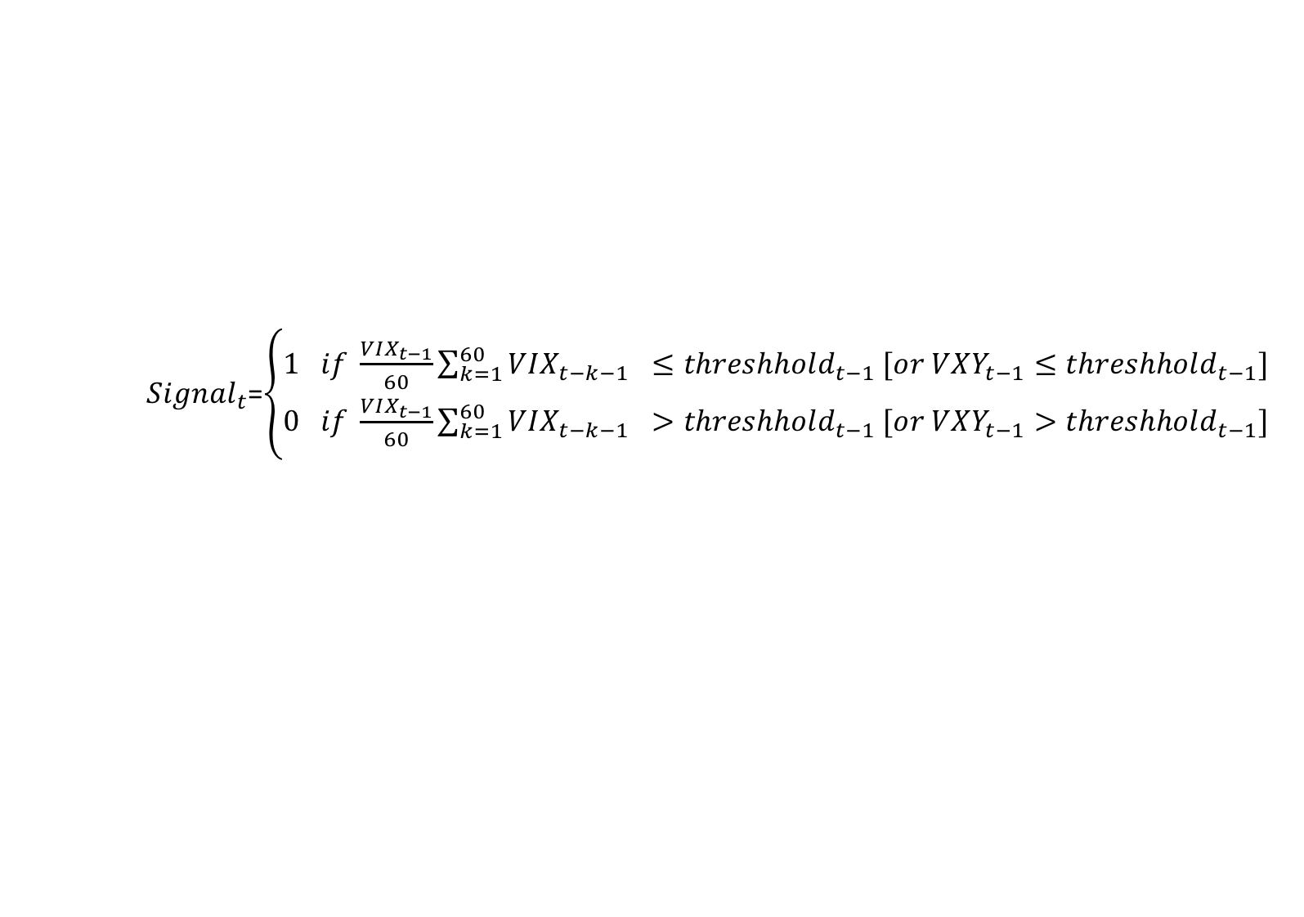
Methodology
1
By default, each period carry trade is realized:
– equally-weighted portfolio of 3 currencies with the highest FDs is purchased
– equally-weighted portfolio of 3 currencies with the lowest FDs is sold
2
Carry trades are stopped when volatility-driven signals prescribe (when Signal = 1)*:
$Signal_{t}$=$\left\{\begin{aligned}1 if VIX_{t−1}≤threshhold_{t−1} [or the same for VXY_{t−1}] \\ 0 if VIX_{t−1}>threshhold_{t−1}[or the same for VXY_{t−1}]\end{aligned}\right.$
OR (in case of volatility deltas):
$Signal_{t}$=$\left\{\begin{aligned}1 if \frac{VIX_{t−1}}{60}\sum_{k=1}^{60}{VIX_{t−k−1} }≤threshhold_{t−1} [or VXY_{t−1}≤threshhold_{t−1}] \\ 0 if \frac{VIX_{t−1}}{60}\sum_{k=1}^{60}{VIX_{t−k−1} }>threshhold_{t−1} [or VXY_{t−1}>threshhold_{t−1}]\end{aligned}\right.$
3
Thus, excess return on the strategy may be specified as:
$$Excess return_{t}^{Carry dynamic}=Excess return_{t}^{Carry}∗Signal_{t}$$
*Threshholds for particular implied volatilities and changes in them are determined dynamically using expanding window approach

Slide 7
Data used
Data frequency: daily
Period analyzed: 31.12.1996 – 31.05.2014
10 currencies considered*: AUD, CAD, CHF, EUR, GBP, JPY, NOK, NZD, SEK, USD
Equity implied volatility index : VIX Index, including near-maturity options vs S&P 500 index
Currency implied volatility index : JP Morgan G7 volatility index
*For period before EUR appearance (01.01.1999) DEM is taken instead

Slide 8
Results (1): Insights from visual analysis
Implied volatility indexes move together (p=0.77)
Average strategy return
=5.38% per year
Strategy Sharpe ratio is equal to 0.57
At a glance, strategy returns are negatively correlated with both indexes

Slide 9
Results (2): Timing strategies based on implied volatility
Currency carry
trades showed poor performance in days of high VIX and VXY
Ability to account volatility immediately would increase strategy performance

Slide 10
Results (3): Timing strategies based on implied volatility Δ
Currency carry
trades showed poor performance in days of high VIX and VXY growth
Improvements are still insignificant and mostly come from decreased volatility

Slide 11
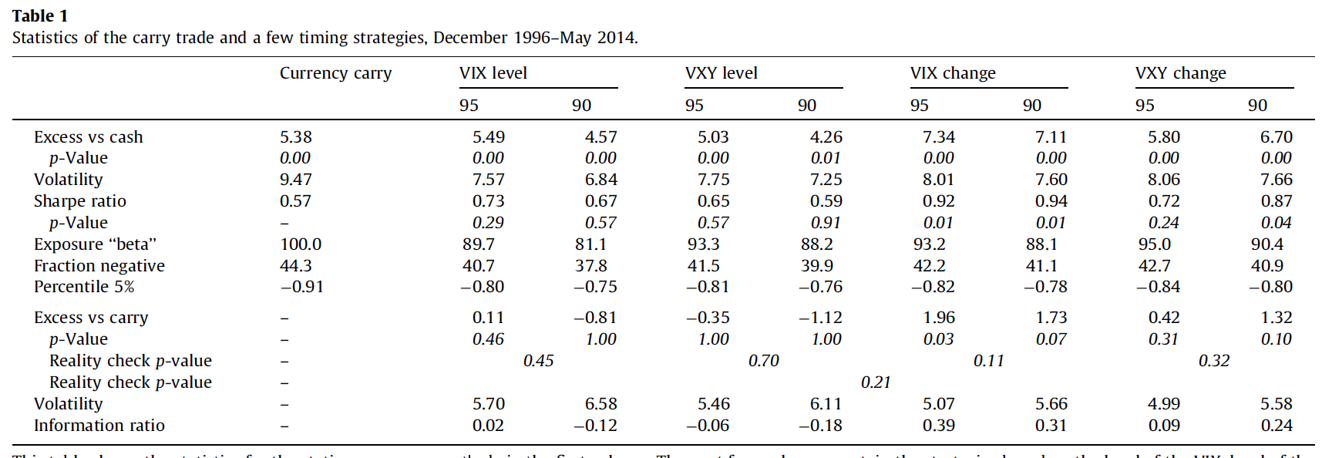
Results (4): Aggregated results
Currency carry trades are contemporaneously exposed to high and increasing implied volatility in both equity and FX markets with very limited predictivity by this risk factor

Slide 12
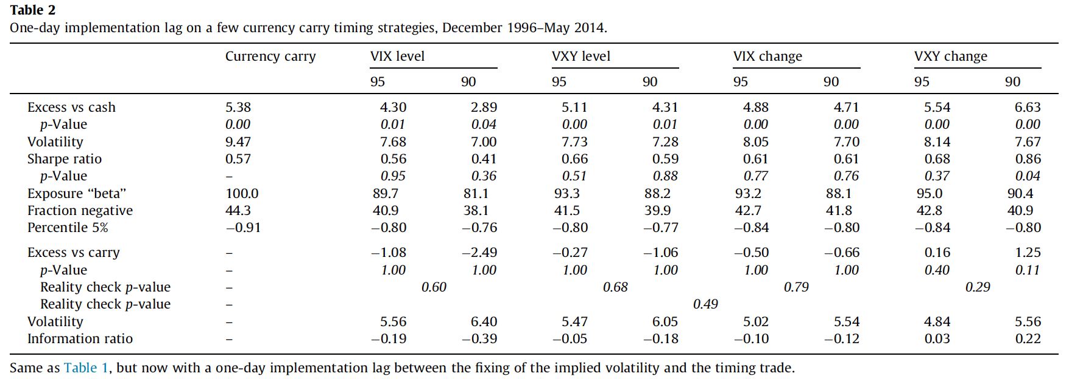
Results (5): Aggregated results – 1-day lag scenario
Possible 1-day lag in changing strategy based on implied volatility eliminates
Informational content of the latter and does not improve strategy results

Slide 13
Conclusions
1
Implied volatility of equity and currency markets is a strong negative contemporaneous indicator of currency carry trade returns
Implied volatility of equity and currency markets is a weak predictive indicator of future currency carry trade returns, changes in volatility levels are a bit more predictive than actual volatility levels
2
3
The results are robust to using various measures of economic uncertainty and consistent with the existence of time-varying risk premia

Slide 14
Part II. Presentation of our replicating results

Slide 15
Research criticism
1
Calculation of forward discounts, on which currency choice is based each period, is not specified
2
Choices of time period and range of currencies analyzed are not visual analysis

Slide 16
Thank you for attention!

